Slide 1
Development and Application Of Concussion Sensors MEMS Accelerometers
Name: Vasishta Hd
Semester: IV Sem
USN No:1RV13IT058

Slide 2
Introduction
What is concussion ?
Symptoms
Causes

Slide 3
Literature Survey
"Estimating Energy Expenditure Using Body-Worn Accelerometers": A Comparison of Methods ,Sensors Number and Positioning by Marco Altini, Julien Penders, Ruud Vullers, and Oliver Amft at the IEEE JOURNAL OF BIOMEDICAL AND HEALTH INFORMATICS, VOL. 19, NO. 1, JANUARY 2015-
"A high sensitivity micromachined accelerometer with an enhanced inertial mass SOI MEMS process" by XIE Jianbing, SONG Meng, YUAN Weizheng from Micro and Nano Electromechanical Systems Laboratory, Northwestern Polytechnical University, Xi’an, China (2014)
" Security in Wireless Sensor Networks for Health Monitoring Helmet with Anomaly Detection using Power Analysis and Probabilistic Model " by Biswajit Panja ,Zachary Scott University of Michigan-Flint, MI 48502 at the 2014 IEEE Conference on Wireless Sensors (ICWiSE), October, 26-28 2014, Subang, Malaysia
"3-AXIS ACCELERATION SWITCH FOR TRAUMATIC BRAIN INJURY EARLY WARNING" by L. J. Currano1, C. R. Becker1, G. L. Smith1, B. Isaacson2, and C. J. morris1 from 1U.S. Army Research Laboratory – U.S.A. 2General Technical Services (for ARL) – U .S.A.

Slide 4
Motivation
"A Compact Sensor System for Concussion Mitigation in Helmets – A Concept Prototype" by Veena Divya K, Deepashree Devaraj, Rajasree PM and Anmol Oberoi -The Department of Instrumentation Technology, R.V. College of Engineering, Bangalore, India.
Detection of level of impacts to head
This System gives an indication though a LED
Communicates to the emergency contacts fed to the GSM through wireless communication
Suggests for further work in the development of energy efficient and better quality sensors

Slide 5
Objectives
Development of more comfortable and better concussion sensor.
Use of open source technologies for cheaper products.
Transmission of data .
Research and future medical reference.
MEM accelerometer .

Slide 6
Methodology
MEMS Accelerometer:
small size
robust sensing feature
Integrated easily
high stability and linearity

Slide 7
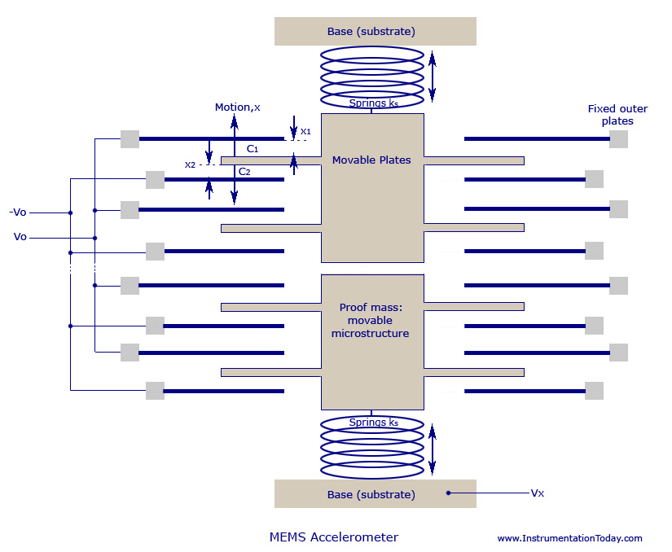
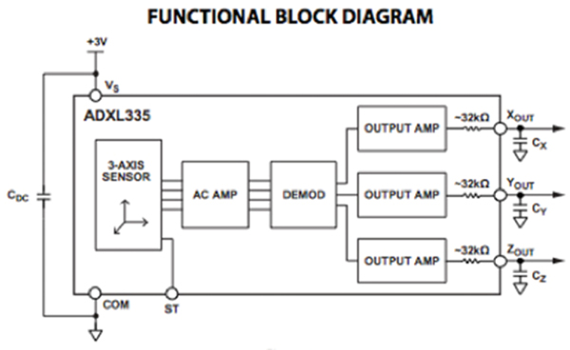
C₀ = E₀.E A/d = E_{A}/d E_{A} = E₀EA
more sets of capacitors are kept in 90 degrees to each other you can design 2 or 3-axis accelerometer

Slide 8
Specifications of a suitable accelerometer - ADXL335
The ADXL335 is a small, thin, low power, complete three-axis accelerometer with signal conditioned voltage outputs.
Can measure the static acceleration of gravity in tilt-sensing applications, as well as dynamic acceleration resulting from motion, shock, or vibration.
Bandwidth of the accelerometer is of range of 0.5 to 1,600 Hz for the x and y-axes, and a range of 0.5 to 550 Hz for the z axis.
The ADXL335 is available in a small, low-profile, 4 × 4 × 1.45 mm, 16-lead, plastic lead-frame chip-scale package .

Slide 9
Budget and other financials:
The National Football League could spend more than $914 million to settle concussion claims.
market price of "brain sentry impact counter plus" - >$75.00
Athletes, students, construction workers, military.
Our model:
Cost Of accelerometer sensor ADXL335 -Rs 250
Controller -Arduino Uno :Rs 750
Bluetooth Module : Rs 600
Other Fabrication cost : Rs200 -Rs500
Total Cost :Rs 1800-Rs 2100

Slide 10
Institutions working on Concussion Sensors
Organisations like National Football league ,USA fund research in this area.
Companies like "Head case" , "Shock Box ", "Jolt " ,"Brain Sentry " , "X2 Biosystems", "Battle Sports" and "CheckLight" are into research , development and manufacture of concussion related products
Research organisations like American Academy of Neurology ,Michigan NeuroSport Program are also working in this domain

Slide 11
Conclusion
Highly implementable.
Future work :nanotechnology, Better processing of data.
More comfortable and wearable.
Other Area Implementation.
Self generation Of Power.
Response Systems.

Slide 12
References
Estimating Energy Expenditure Using Body-Worn Accelerometers": A Comparison of Methods ,Sensors Number and Positioning by Marco Altini, Julien Penders, Ruud Vullers, and Oliver Amft at the IEEE JOURNAL OF BIOMEDICAL AND HEALTH INFORMATICS, VOL. 19, NO. 1, JANUARY 2015
"A high sensitivity micromachined accelerometer with an enhanced inertial mass SOI MEMS process" by XIE Jianbing, SONG Meng, YUAN Weizheng from Micro and Nano Electromechanical Systems Laboratory, Northwestern Polytechnical University, Xi’an, China (2014)
" Security in Wireless Sensor Networks for Health Monitoring Helmet with Anomaly Detection using Power Analysis and Probabilistic Model " by Biswajit Panja ,Zachary Scott University of Michigan-Flint, MI 48502 at the 2014 IEEE Conference on Wireless Sensors (ICWiSE), October, 26-28 2014, Subang, Malaysia
"3-AXIS ACCELERATION SWITCH FOR TRAUMATIC BRAIN INJURY EARLY WARNING" by L. J. Currano1, C. R. Becker1, G. L. Smith1, B. Isaacson2, and C. J. morris1 from 1U.S. Army Research Laboratory – U.S.A. 2General Technical Services (for ARL) – U .S.A.
M. S. Muller, T. C. Buck, H. J. El-Khozondar, and A. W. Koch, “Shear Strain Influence on Fiber Bragg Grating Measurement Systems,” J. Light. Technol., vol. 27, no. 23, pp. 5223–5229, Dec. 2009. Petchprapai N, Winkelman C (2011).
S. Javdani, M. Fabian, M. Ams, J. Carlton, T. Sun, and K. T. V. Grattan, “Fiber Bragg Grating-Based System for 2-D Analysis of Vibrational Modes of a Steel Propeller Blade,” J. Light. Technol., vol. 32, no. 23, pp. 3991–3997, Dec. 2014 Palmer J.W, Bing K.F, Sharma A.C, Greneker E.F.
‘DetectingConcussion Impairment with Radar Using Gait Analysis Techniques’.Radar Conference (RADAR), 2011 IEEE. Page(s): 222 - 225 , Publication Year: 2011 . Slobounov S, Sebastianelli W, Newell K.M.’ Incorporating Virtual Reality Graphics with Brain Imaging for Assessment of Sport-Related Concussions’
wwwsparkfun.com/datasheets/Components/SMD/adxl335.pdf
https://www.google.co.in/url?sa=t&rct=j&q=&esrc=s&source=web&cd=8&cad=rja&uact=8&sqi=2&ved=0CEgQFjAH&url=http%3A%2F%2Fwww.nlm.nih.gov%2Fmedlineplus%2Fconcussion.html&ei=dIjmVP3KJsfIuATCmIKIAg&usg=AFQjCNFIkNdTLM9HQKzUIqB9V3EeOQy0Mg

Slide 13
Q&A

Slide 14
Thank You

